Slide 1
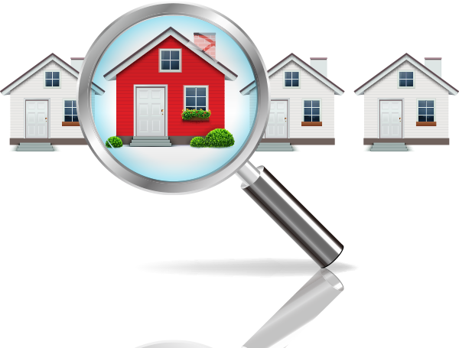
Houses Madrid Analysis

Slide 2
Key Insights on House Prices by Features
Houses with a Garden: The average house buying price for properties with a garden is €1.96 million, indicating a premium for outdoor spaces.
Houses with a Pool: Homes with a pool are priced at an average of €1 million, making them attractive for buyers looking for luxury features at a relatively moderate cost.
Houses with Both Garden and Pool: Properties with both features come at a higher price point of €2.11 million, highlighting the added value of combined amenities.
Houses without Garden or Pool: On the lower end, houses without a garden are priced at €824.31k, and those without a pool average €985.78k. Properties lacking both amenities are priced at €942.33k.

Slide 3
Average Square Meter Price by House Type
Cottages: Lead the market with the highest average square meter price of 48.7%, showing their exclusivity and value.
Pisos: With an average price of 16.98% per square meter, they rank second, appealing to urban buyers looking for smaller apartments.
Áticos: Priced similarly at 16.19%, these rooftop apartments offer luxury with views and outdoor spaces.
Duplex: These properties have a 12.78% average price per square meter, catering to families looking for multi-level homes.
Casa o Chalet: These houses have the lowest average price per square meter at 5.35%, but they tend to offer larger living spaces.

Slide 4
Square Meters Built by House Type
Pisos: With 770k sq. meters built, pisos dominate the market in terms of total space built.
Casa o Chalet: Come second with 642k sq. meters, making them attractive for larger family homes.
Áticos: Account for 105k sq. meters, offering compact yet premium living spaces.
Duplex: With 68k sq. meters, duplex properties are built for families preferring vertical living.
Cottages: Represent a niche market with only 4k sq. meters built, highlighting their rarity.

Slide 5
Relationship Between Square Meter Price and Area Built
Cottages, despite their small built area, have the highest square meter price, indicating strong demand for these rare properties. Conversely, pisos, which have the most built area, command a relatively lower price per square meter. This suggests that exclusivity drives up price per square meter, while mass availability tends to reduce it.

Slide 6
Lucrative Investment Opportunities
1. Cottages: High price per square meter and limited supply make these rare gems ideal for investment.
2. Áticos: Their combination of compact luxury and outdoor space offers a solid return.
3. Pisos: High availability ensures consistent demand, making them reliable for long-term gains.
4. Duplex: With a growing market, these homes cater to families seeking more space.
5. Casa o Chalet: While offering the lowest price per square meter, these houses provide substantial living space, making them a good value investment.

Slide 7
Exterior and New Development Impact on Prices
Exterior Impact: Houses with an exterior feature have a lower average price of €808k, while those without are priced significantly higher at €1.717 million. This suggests that buyers place less importance on outdoor views than on other property features.
New Development Impact: New developments average €638k, compared to €1.071 million for older homes, implying that newer properties are more affordable, potentially attracting first-time buyers or investors looking for modern amenities.

Slide 8



Pankaj Singh
Data Analyst
Full Video Link-1: https://youtu.be/jvZQNOgcmU8
PPT Link-2: https://youtu.be/gGedhuQgMRA
Fellow For More Data Analyst Projects And Analytics' Resources…
YouTube: https://www.youtube.com/@DProjectshub-99
LinkedIn: www.linkedin.com/in/bpankaj-singh20
GitHub: https://github.com/pankajsingh20

Slide 9
Thank you…

